Slide 1

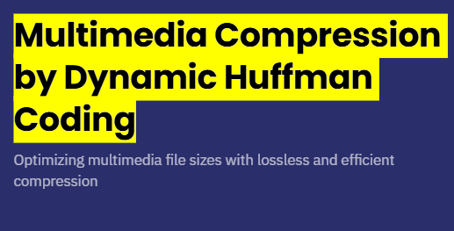
Multimedia Compression by DynMultimed Compression by Dynamic Huffman Codingami Huffman Coding
This web application offers a powerful and scalable platform for compressing images, videos, and text files with high quality preservation. It is built to ensure ease of use and efficient processing, catering to diverse user needs.
Audio compression is as of now excluded to focus resources on optimizing compression for other media types, ensuring superior performance and reliability across supported formats.

Slide 2
Introduction
This presentation covers the architecture and core features of a web application designed for multimedia compression. The platform supports compressing images, videos, and text files, with a user-friendly interface and REST API endpoints. The backend manages file uploads, compression processing, and returns compressed file previews and downloads through REST API endpoints. It handles image and video compression by resizing and quality adjustment, and text compression via Huffman coding. The server is built with Flask, ensuring modular and scalable service management . Files uploaded via the web interface are saved in designated folders, then processed and stored in compressed output directories. File handling ensures efficient reading, saving, and cleanup for smooth user experience. Preview and download functionalities are integrated for easy access.

Slide 3
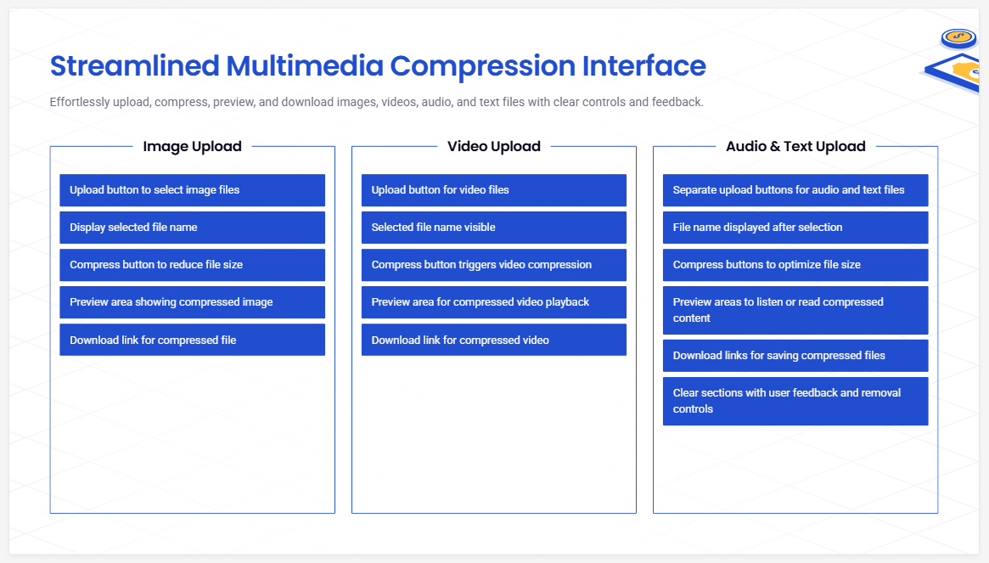

Slide 4
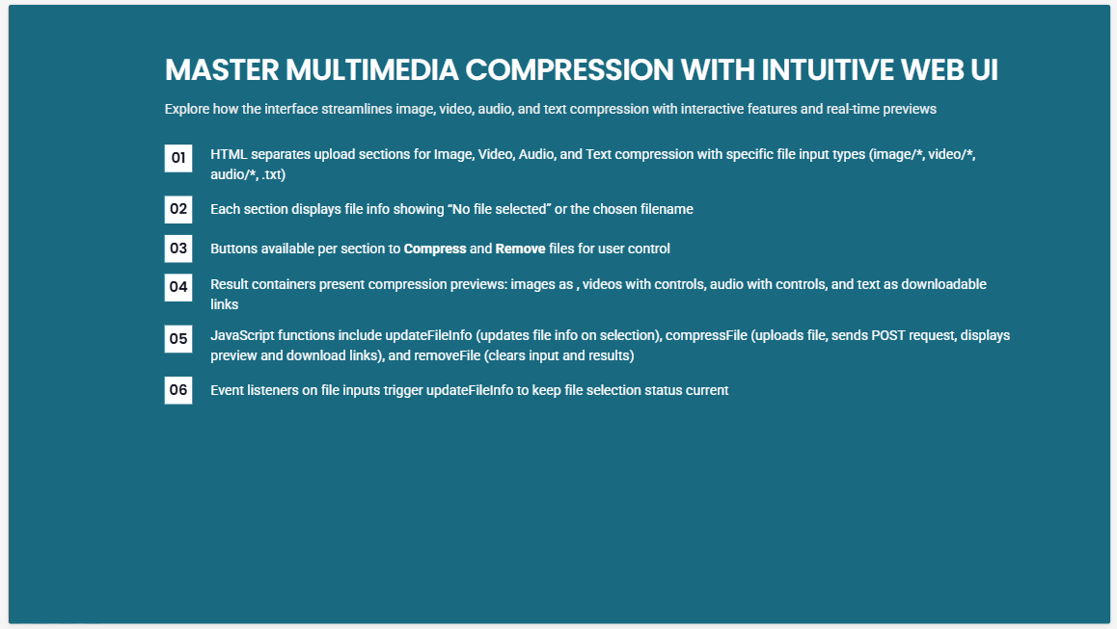

Slide 5
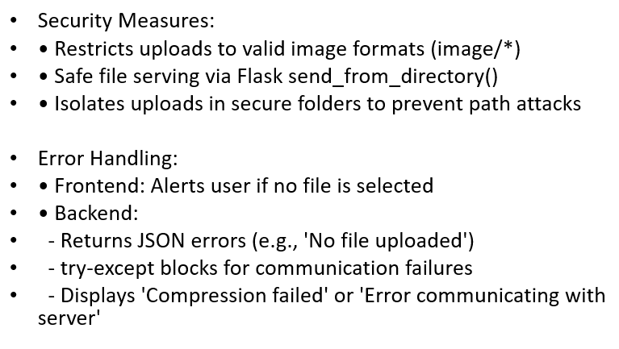
Security and Error Handling
The application makes sure a file is actually there before starting compression, so you won’t waste time or get unexpected errors. If something goes wrong, it gives clear messages to help you understand what happened and how to fix it.but effective checks to keep file paths safe, preventing unauthorized access. This keeps your data secure and the whole process reliable, making sure your files stay protected.

Slide 6
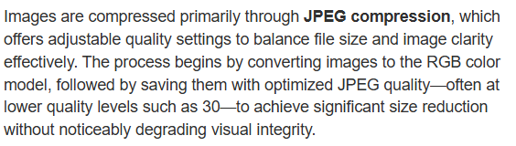
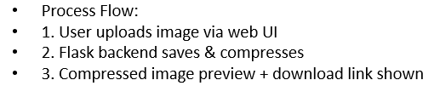
Image Compression Techniques
Image compression here works by resizing images and converting them to optimized JPEGs, which helps shrink file sizes without losing much visual quality. This balance ensures your pictures look great while taking up less space.
The app also offers handy features like grayscale conversion and adjustable quality settings.
These let you customize compression for different types of images, all within a simple and user-friendly interface that makes the process smooth and efficient.

Slide 7

Video Compression
Implementation
The application validates file presence before processing and returns appropriate error messages for missing files or failed compression tasks. Basic security mechanisms manage file paths to prevent unauthorized access, maintaining reliability and data integrity.The web application implements robust error handling by verifying file uploads before compression and returning clear error messages if files are missing or compression fails. Path management safeguards prevent unauthorized file access, ensuring system integrity. These mechanisms contribute to a reliable and secure user experience, minimizing errors during multimedia processing.

Slide 8
Text Compression Using Huffman Coding
Text compression is implemented with Huffman coding, a lossless compression algorithm based on character frequency. The system builds a binary tree of character codes to encode the text into compact binary data. This method efficiently reduces text file size without any data loss, ideal for compressing documents uploaded via the web interface.

Slide 9

Conclusions
This web application efficiently compresses images, videos, and text files using established algorithms and frameworks, excluding audio compression as specified. Its secure backend validates input and manages errors to ensure reliability. The flexible compression methods maintain quality and performance, providing users with an accessible, robust tool for multimedia file size reduction.

Slide 10


